Slide 1

Comparison in Delhi & Sikkim in air pollution
Chitranshi Bansal
10-A 41

Slide 2
CONTENTS
2. Sikkim environment
What is air pollution
3. Delhi environment
4. Comparison in delhi & sikkim

Slide 3
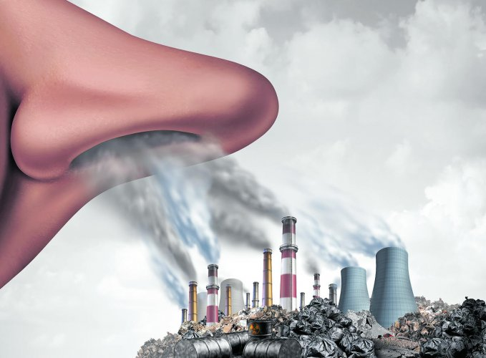
AIR POLLUTION
Air pollution is a mixture of solid particles and gases in the air. Car emissions, chemicals from factories, dust, pollen and mold spores may be suspended as particles. Ozone, a gas, is a major part of air pollution in cities. When ozone forms air pollution, it's also called smog.
Air pollution is caused by solid and liquid particles and certain gases that are suspended in the air. These particles and gases can come from car and truck exhaust, factories, dust, pollen, mold spores, volcanoes and wildfires.

Slide 4
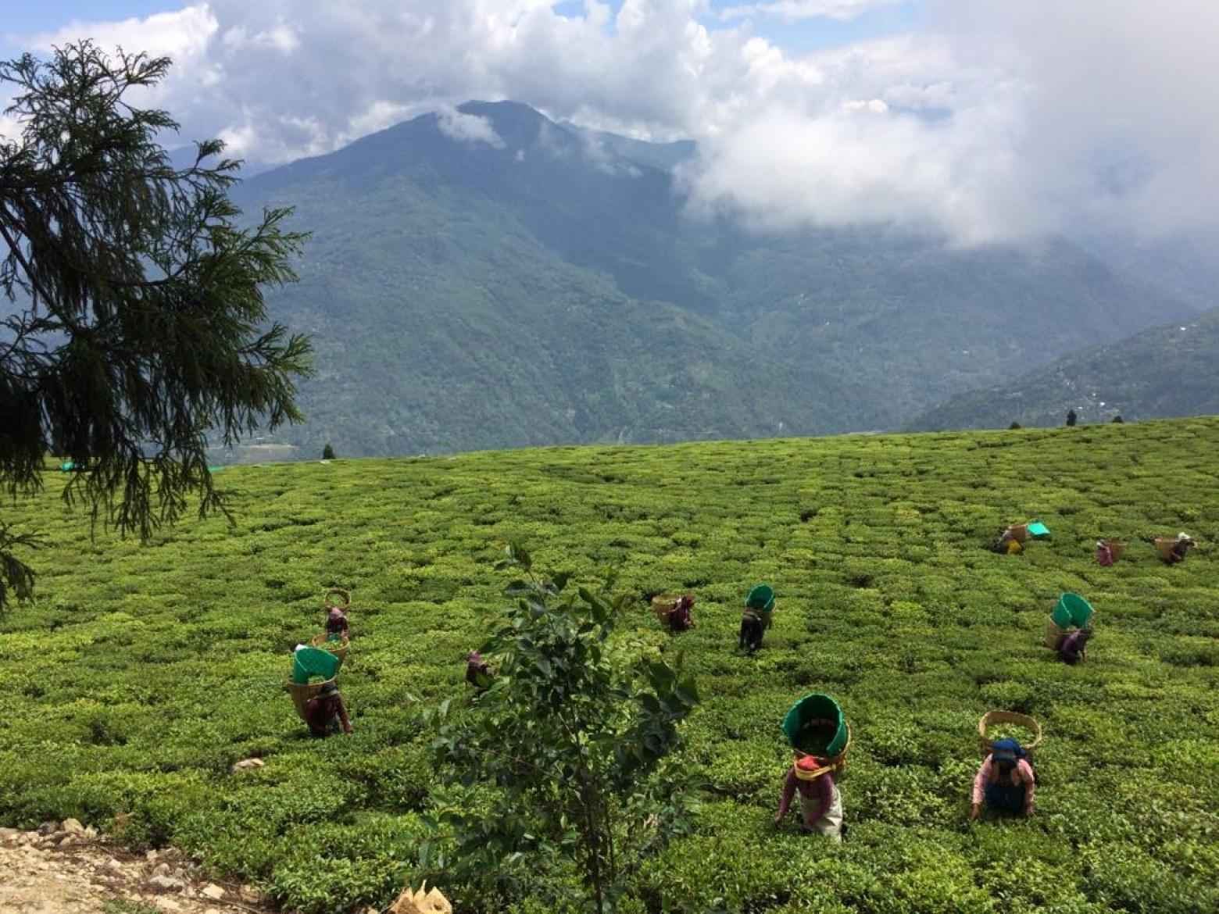
SIKKIM ENVIRONMENT
Sikkim is bestowed with majestic mountains, beautiful hills and valleys, crystal clear water falls, springs and lakes, rivers and streams, steep and undulating terrains, snow clad mountains, low lying land ranging from altitude of 310 m (Jorethang) to 8586m (Mount Khangchendzonga) from MSL. Forest land is interspersed with varied forms of flora and fauna. State lies in the Eastern Himalayas which is a biodiversity hotspot. Forests in Sikkim harbor host of endemic flora, rare and endangered species of plants and animals, high value medicinal plants etc. Sikkim is a botanist’s paradise.The people of Sikkim are environmentally aware ..

Slide 5
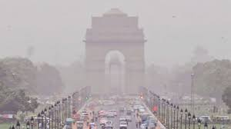
DELHI ENVIRONMENT
Environmental problems in Delhi, India, are a threat to the well-being of the city's and area's inhabitants as well as the flora and fauna. Delhi, the ninth-most populated metropolis in the world (second largest if the entire NCR includes especially Faridabad and Gurugram– Haryana, is one of the most heavily polluted cities in India,having for instance one of the country's highest volumes of particulate matter pollution. The air quality index of Delhi is generally moderate (101–200) level between January to September, and then it drastically deteriorates to Very Poor (301–400), severe (401–500) or hazardous (500+) levels in three months between October and December, due to various factors including stubble burning, fire crackers burning during Diwali and cold weather.In May 2014 the World Health Organization announced New Delhi as the most polluted city in the world.

Slide 6
COMPARISION
FEATURES
SIKKIM POLLUTION
DELHI POLLUTION
Air Pollution | Very Low | 9.38 | Very High | 88.13
Drinking Water Pollution and Inaccessibility | Low | 33.33 | High | 62.48
Dissatisfaction with Garbage Disposal | Low | 34.38 | High | 74.56
Dirty and Untidy | Low | 28.12 | High | 71.51
Noise and Light Pollution | Moderate | 40.62 | High | 64.02
Water Pollution | Moderate | 46.88 | High | 77.42
Dissatisfaction to Spend Time in the City | Low | 21.88 | High | 78.79
Air Quality | Very High | 90.62 | Very Low | 11.87

Slide 7


